Slide 1
Penetration Assessment Tools
Drew Lepley

Slide 2
How the Phases of Compromise Align with The Pen Testers Methodology
There are multiple phases to any penetration test, and the phases of compromise are enveloped within these. To begin before getting into the phases, penetration testing is an extremely important job in the cyber security industry, and without them, businesses would be a lot more susceptible to having data leaks and hackers trying to attack them. Pen testing allows for businesses to freely get hacked and tested without any risk, as they paid the pen tester to test the network and scan it for vulnerabilities. With that being said, the pen test begins with recon. This essentially means that the tester will be going around “sniffing” the network to see if there are any open ports or any parameters on the network the tester can search without doing any damage or getting caught. Basic network sniffing does not ring any bells for security because it technically is not any threat unless they act upon the information. One the hacker or pen tester has a good feel for the network, and what he/she is dealing with, the next phase begins, which would be to identify the vulnerabilities and find places to plan the attack. The third phase is to act upon the recon that they have done, where the attacker will try to get into the network undetected and gain access to more significant targets. Many of the exploitable tactics that hackers use are network attacks, which would include DDOS attacks and web application and database attacks. After this phase, it’s time to clean up, as the attacker will try to restore everything to normal if they go undetected, and they will get out with the information. For the penetration tester, this is where the report would be written and a very detailed review of everything, they did within the network would be given to the business.

Slide 3
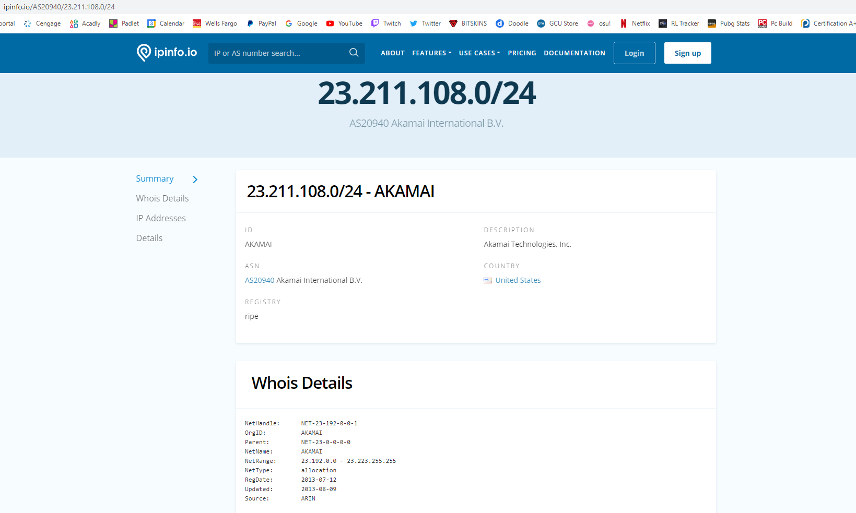
Reconnaissance OSINT
WHOIS: Whois is a widely used Internet record listing that identifies who owns a domain and how to contact them. Very useful for defending and identifying hackers attacking the system or network. This can be hard to identify if hacker is using proxy’s or a VPN.

Slide 4
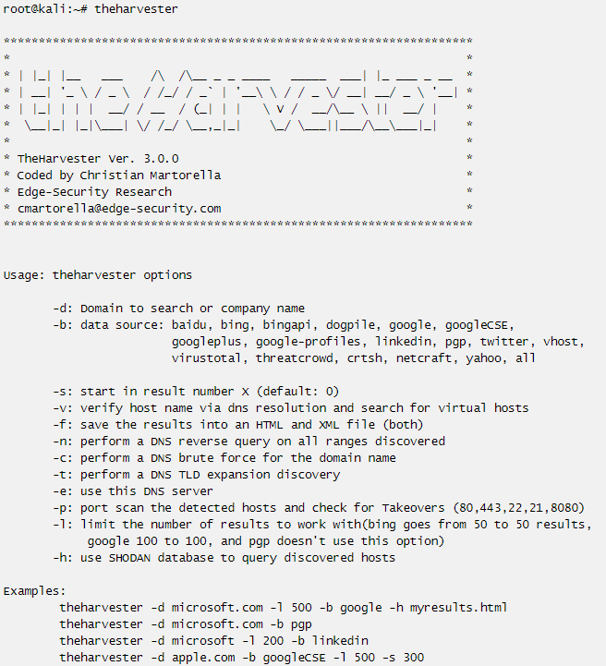
Reconnaissance OSINT
The Harvester - The objective of this program is to gather emails, subdomains, hosts, employee names, open ports and banners from different public sources like search engines, PGP key servers and SHODAN computer database. This tool helps pen testers by getting the customer footprint on the internet in the earlier stages of the penetration test.

Slide 5
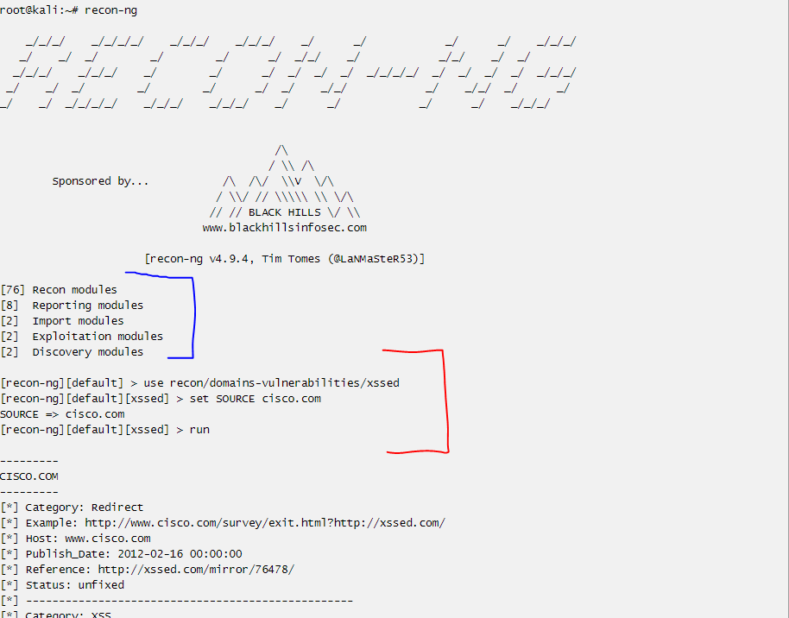
Reconnaissance OSINT
Recon-ng: By far the best tool for any reconnaissance work that needs to be done on a network or anywhere on the internet. It provides a powerful environment in which open-source web-based reconnaissance can be conducted quickly and thoroughly. You can use a “marketplace” command to download different modules (seen in blue) and then use commands (seen in red) to set up the module and run it. This example has the source set to cisco.com, where this module looks like a vulnerability scanner, which will scan cisco.com

Slide 6
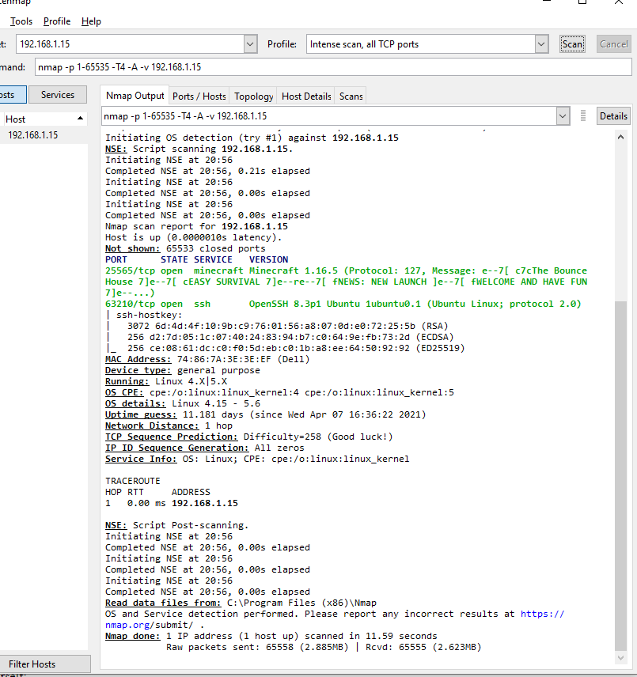
Network and Host Vulnerability Scanning
NMAP – Another personal favorite, Nmap targets a host or network and discovers open ports on the host. This would mean that if a host was scanned, any ports that were open like ssh (22) would be shown within nmap. I have an ubuntu server that runs a couple of games, and has ports open, so scanning that would show open ports on the host. I ran the scan on my windows machine which is why I downloaded nmap for windows. I have set up my server so ssh doesn’t come out port 22 and instead is port 63210, funny enough you can also see the Minecraft server on port 25565 open and even see the server details. Nmap is a great tool and gives a ton of information about the server or host it is scanning.

Slide 7
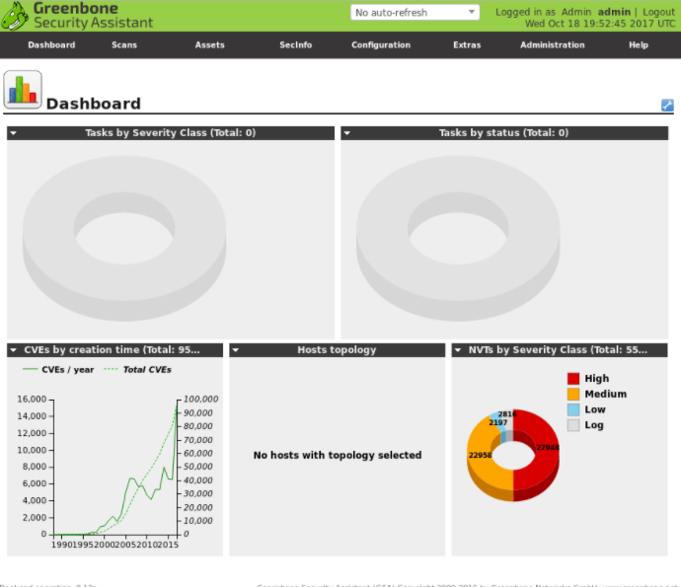
Network and Host Vulnerability Scanning
Greenbone Openvas- OpenVAS is a full-featured vulnerability scanner. Its capabilities include unauthenticated testing, authenticated testing, various high level and low-level Internet and industrial protocols, performance tuning for large-scale scans and a powerful internal programming language to implement any type of vulnerability test.

Slide 8
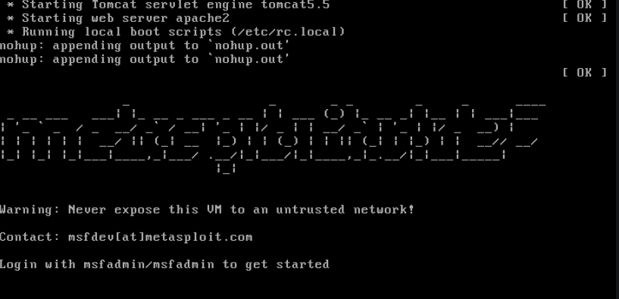
Network and Host Vulnerability Scanning
Metasploit Framework - The Metasploit framework is a very powerful tool which can be used by cybercriminals as well as ethical hackers to probe systematic vulnerabilities on networks and servers. Because it's an open-source framework, it can be easily customized and used with most operating systems. Metasploitable has multiple commands and attack vectors too expose and exploit hosts.
MfsConsole - The msfconsole is probably the most popular interface to the Metasploit Framework (MSF). It provides an “all-in-one” centralized console and allows you efficient access to virtually all of the options available in the MSF.
MfsVenom - MSFvenom is a combination of Msfpayload and Msfencode, putting both tools into a single Framework instance. One single tool,
Standardized command line options, and
Increased speed.

Slide 9
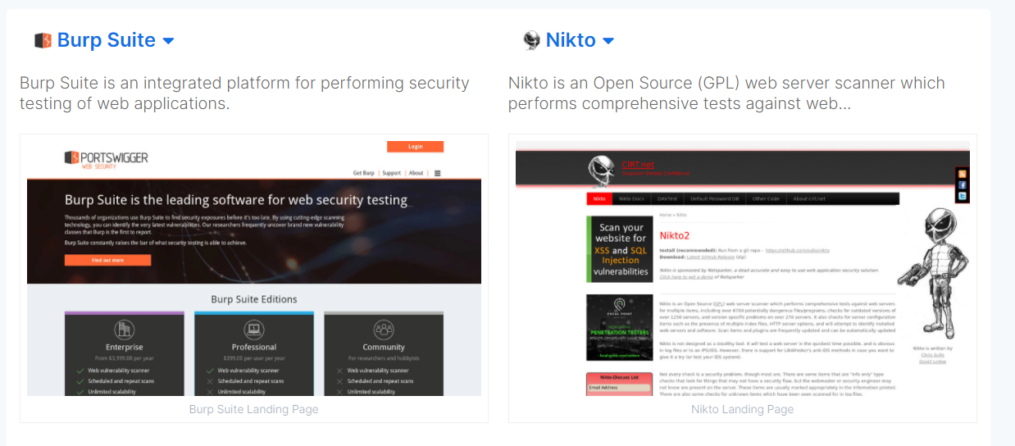
Network and Host Vulnerability Scanning
Burpsuite and Nikto
Very similar, but Nikto is a free software command-line vulnerability scanner that scans webservers for dangerous files/CGIs, outdated server software and other problems.
Burpsuite is very similar, but also has tools including spider, proxy, intruder, repeater, sequencer, decoder, extender, and scanner.

Slide 10
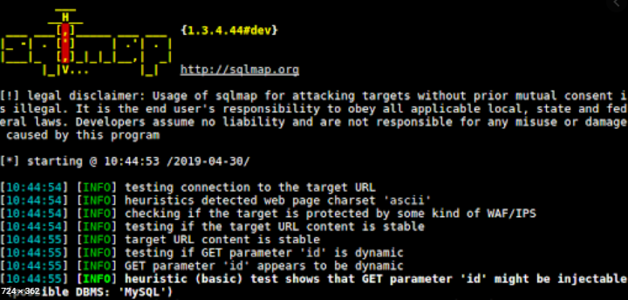
Network and Host Vulnerability Scanning
SQL Injection / SQLmap
SQL injection and SQLmap are both very interesting topics, as a SQL injection is a source of code that is injected within a search bar or login bar that executes code on the host side and outputs information it shouldn’t. For example, if an sql injection was done on a database through a search bar and it was properly done, usernames and passwords from that database would be shown on the webpage in clear view, most likely encoded but that’s another topic.
SQLmap takes a more automated side in kali linux, where you are using commands within a CLI to execute code and attack the website. For example, first logging in with Admin, admin, will give us a url, which is then edited and used to attack the admin vector of the website, allowing for multiple databases to be shown to the user.

Slide 11
Evaluation of Cyber Laws and Ethical Hacking
Code 13-2316 - Title 13 in code 2316 which basically states that any person that tampers with a computer system without permission or authorized access has performed some type of tampering. Not only that, but the law also clearly states various types of tampering which includes destroying, damaging, accessing, or altering the system. It goes on to address that performing attacks that deny access such as a DDOS attack or perform an attack that could hurt any one physically or emotionally is deemed illegal.
Code 18-502 - 18-502 relates to more malware and ransomware attacks, where it states that transmitting software to control or access another person’s computer is unlawful. This would include any program that takes or prevents access from the user without the user’s permission especially if it is to do harm.

Slide 12
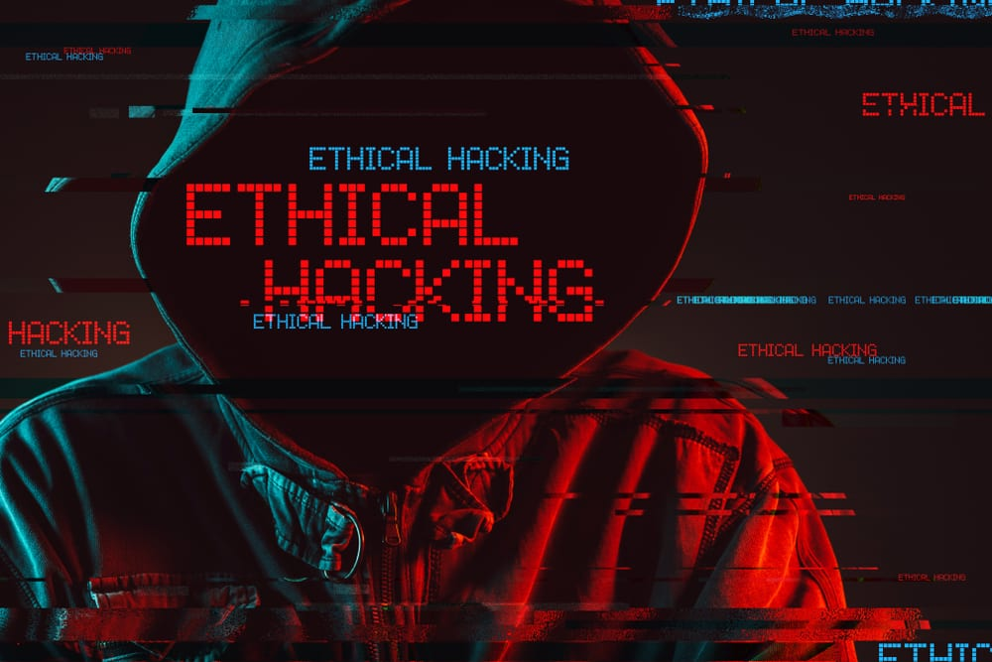
Evaluation of Cyber Laws and Ethical Hacking
Ethical hacking is one of the most essential tools in the cyber security business. The reason this is extremely important is because ethical hacking is essentially taking the bad guy’s place and running a simulation of the attack, almost like there had been a bad dream or a nightmare. Once you wake up, or once the ethical hacking is done, the network can go back to normal, and it can be reviewed to patch exploits or vulnerabilities that were found. The Bible says, “Whatever you do, do it all for the glory of God”, and this verse correlates to cyber security professionals and ethical hackers to be the greater good and help others protect private information from those who want to harm others physically, mentally, or even financially.

Slide 13
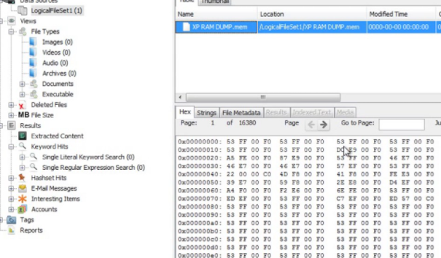
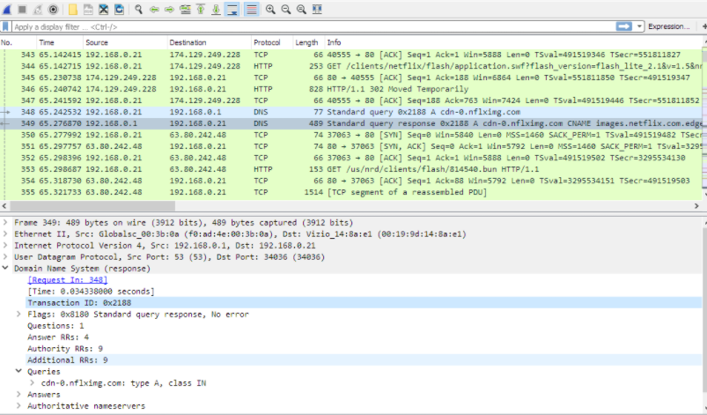
Forensic Evaluation Tools
Autopsy - Autopsy is a digital forensics platform and graphical interface to The Sleuth Kit and other digital forensics tools. It is used by law enforcement, military, and corporate examiners to investigate what happened on a computer. You can even use it to recover photos from your camera's memory card. This is super helpful for creating a case and analyzing a hard drive or disk from a computer. This is mainly used for physical evidence and hard drives where Wireshark is going to be much more network related analysis.
Wireshark - Wireshark is a free and open-source packet analyzer. It is used for network troubleshooting, analysis, software and communications protocol development, and education. Wireshark allows you to analyze pcap files or run a constant scan of the network or interface you want to analyze, and it will scan and show all network data going across including https, TCP, and UDP data.

Slide 14
Why Pen Testing is Necessary in Cyber Security
The main reason penetration tests are crucial to an organization’s security is that they help personnel learn how to handle any type of break-in from a malicious entity. Pen tests serve to examine whether an organization’s security policies are genuinely effective. They serve as a type of fire drill for organizations. Penetration tests can also provide solutions that will help organizations to not only prevent and detect attackers but also to expel such an intruder from their system in an efficient way. Not only that, but its gotten increasingly more important because of how prevalent hacks and data breaches are. 47% of data leaks were caused by hackers and or malicious attacks, and the rest were caused by human error, but having half of data leaks caused by something that can be fixed by a penetration test is something that should be top priority. Pen testing takes the place of the hacker and creates a safe area to test the network and secure it so malicious attacks need to either be much more targeted or take much more time to create.

Slide 15
References
A Complete Guide to the Phases of Penetration Testing. (2019, December 10). Retrieved from https://cipher.com/blog/a-complete-guide-to-the-phases-of-penetration-testing/
Calculating Consequences: The Utilitarian Approach to Ethics. (n.d.). https://www.scu.edu/ethics/ethics-resources/ethical-decision-making/calculating-consequences-the-utilitarian-approach/
FindLaw for Legal Professionals: Law & Legal Information. (n.d.). https://lp.findlaw.com/
Grimes, R. A. (2019, February 27). What is ethical hacking? How to get paid to break into computers. https://www.csoonline.com/article/3238128/what-is-ethical-hacking-and-how-to-become-an-ethical-hacker.html
Metasploit Unleashed, Vulnerability Scanning. (n.d) Retrieved from Offensive Security: https://www.offensive-security.com/metasploit-unleashed/vulnerability-scanning
Talamantes, J. (2019, August 26). What Is A Penetration Test and Why Do I Need It? Retrieved from https://www.redteamsecure.com/blog/penetration-test-need/
Top 5 Penetration Testing Methodologies and Standards. (2020, December 11). Retrieved from https://www.vumetric.com/blog/top-penetration-testing-methodologies/
What is Ethical Hacking and Type of Ethical Hackers? (2021, February 10). https://www.simplilearn.com/tutorials/cyber-security-tutorial/what-is-ethical-hacking

