Slide 1
Operation Ivy
Ian, Connor, Ashton, Drew

Slide 2
Table Of Contents
1. Title Page
2. Table Of Contents
3. Project Information
4. Executive Summary
5. Timeline
6. Raid Log
7. Raid Log (continued)
8. Costs and Budget
9. Risk Management Plan
10. Noteworthy Risks
11. Noteworthy Risks (Continued)
12. Security Policies
13. Projected Results

Slide 3
Project Information
Name of Organization: Across The States Bank
Project Title: Operation Ivy
Project Vision Statement: Our vision is to reduce sensitive data exposures and inefficient administration. We will implement I&A Management to provide scalability, ease of administration, and the ability to audit during security incidents all while employing the principles of least privilege.
Project Team members: Ian, Connor, Ashton, Drew

Slide 4
Executive Summary
What? - Identity & Access Management for all of Across the States Bank
Why? - No controls is difficult to manage, scale, and presents many security risks
How? - Using Azure AD, RBAC, and various security policies
Who? - 1 Project Manager and 3 System Administrators
When? - January 3rd, 2022 - September 18, 2023

Slide 5
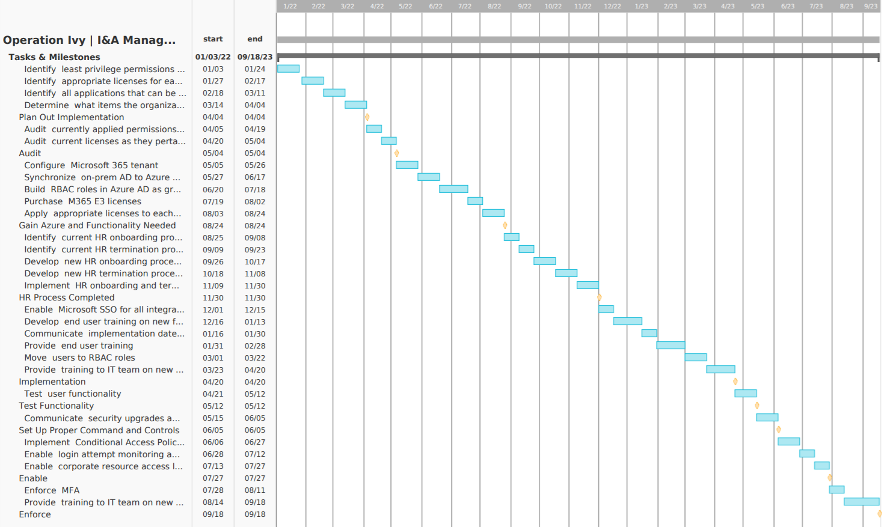
Timeline
Notes:
This project starts in early January 2022 and is estimated to conclude in late September 2023 . The project has been divided up into nine different phases. The first phase is the Implementation planning phase, where licences, applications, systems, and permissions will be identified. In the second phase, the Auditing phase, the licenses, applications, and other resources that have been acquired will be inspected. The third phase, Azure deployment, will consist of transferring the legacy AD to Azure AD, as well as building RBAC roles and purchasing licenses if necessary. The fourth phase consists of restructuring the HR department, as well as deploying additional roles to adapt to the new system. The next phase is the Implementation phase, in which Microsoft SSO will be enabled for compatible applications, and end user training will be provided for users to adapt to the new system. The sixth phase consists of testing the user functionality and ensuring that users can adjust to the changes. The last two phases of the project consist of enabling and enforcing policies such as MFA and training for the IT team. If tasks and milestones are completed on time, this project should be complete by late 2023.

Slide 6
RAID Log
Across the States Bank |  | Operation Ivy | RISKS & ISSUES MANAGEMENT MATRIX
TYPE | TITLE | DESCRIPTION | IMPACT | PROB | SCORE | STRATEGY | OWNER | STATUS
Risk | Loss of user functionality | Users may not have proper permissions and access to complete tasks if configured incorrectly | 4 | 2 | 8 | MITIGATE | Ian Dobson | ACTIVE
Risk | Strict time frame | Roughly 200 locations per day will be maintenanced, resulting in a very strict time frame to complete the project | 3 | 5 | 15 | ACCEPT | Ian Dobson | ACTIVE
Risk | Budget difficult to precisely calculate | Significant labor is required and the hours spent on the project may vary | 3 | 4 | 12 | ACCEPT | Ian Dobson | ACTIVE
Risk | IT Team misconfiguration | IT service teams may inaccurately create new accounts and service accounts initially based on “old ways” | 2 | 2 | 4 | MITIGATE | Ian Dobson | ACTIVE
Risk | "Too Secure" | New security features may be “too secure” causing account lockouts or service interruptions | 2 | 3 | 6 | MITIGATE | Ian Dobson | ACTIVE
Risk | Branch push back | Certain branches may push back on the updates | 3 | 3 | 9 | ACCEPT | Ian Dobson | ACTIVE
Risk | End user awareness | End users may not understand changes and may not pay attention to communications and end user training | 2 | 5 | 10 | MITIGATE | Ian Dobson | ACTIVE
Notes:
The major risk to keep in mind is the strict timeline for deliverables since these can prevent the project for moving forward, if not completed. Other deliverables are accepted or mitigated based on the amount of control over the deliverable.

Slide 7
RAID Log part 2
Assumption | Permissions | Permissions at across the state banks are based on job description | 3 | 1 | 3 |  | Drew Lepley | ACTIVE
Assumption | Cost plan | Cost plan will cover all dependencies | 5 | 2 | 10 |  | Drew Lepley | ACTIVE
Assumption | Cloud implementation | Cloud implementation has better disaster recovery, security and reliability | 3 | 1 | 3 |  | Drew Lepley | ACTIVE
Assumption | Cloud implementation | Cloud implementation will be cheaper and less time consuming than on-premise strategies | 3 | 1 | 3 |  | Drew Lepley | ACTIVE
Assumption | Outdated | Old, outdated devices, not up to date standards, Outdated IE servers, on-premise AD | 3 | 2 | 6 |  | Drew Lepley | ACTIVE
Issues | Older server system | Company has an older system that has plenty of exploits | 4 | 3 | 12 | Mitigate | Connor Johnson | ACTIVE
Issues | Need to provide restuctured access controls | Premade access controls have led to confusing permissions, and will need to be tracked | 4 | 5 | 20 | Mitigate | Connor Johnson | ACTIVE
Issues | Azure Knowledge | Will need to train or hire staff to use Azure | 4 | 5 | 20 | Mitigate | Connor Johnson | ACTIVE
Issues | Availability while underway | Company will need access to information while undergoing transfer to the cloud. | 3 | 4 | 12 | Accept | Connor Johnson | ACTIVE
Issues | Time Restraints | Need to move company infrastructure to the cloud in a timely manner. | 5 | 4 | 20 | Accept | Connor Johnson | ACTIVE
Notes:
The assumptions for this project are related to costs and the implementation conditions such as outdated devices. Issues that will need to be accounted for are based around time restraints and the improvements themselves. If employees do not inform staff of updates or plan accordingly, serious issues and resources can be lost.

Slide 8
Costs and Budget
 | Product Needed | Quantity | Cost
 | Electricity Bill | 17,000 locations | Varies between states
 | Travel Costs |  | $10,000
 | Salary (Project Manager) | 1 | $88,985
 | Salary (System Administrators) | 3 | $73,890
 | Microsoft M365 E3 | 132,000 Users per month | $32 per user/month ($4,240,000 total per month)
Total = |  |  | $320,655 + $4.24M/month
Notes:
The cost of this project is estimated at $320,655 + $4.24M per month. The majority of the cost of this project is due to Microsoft licensing. Microsoft M365 E3 wil be used for each user, and costs $32 per user per month. ASB has over 132,000 employees, which results in a total monthly cost of $4.24M per month. Additional electricity may be needed for this project, but the total cost of electricity is difficult to calculate, as electricity prices vary in different states. Travel expenses are also accounted for, as the project manager and system administrators may need to travel to different ASB locations. Additional funds may be needed for mitigating risks or other unexpected events.

Slide 9
Risk Management Plan
Risk | Description | Mitigation | Closeout
Loss of user functionality | Users may not have proper permissions and access to complete tasks if configured incorrectly | Test each new role to ensure proper permissions and access before implementation | Each role has been tested and still has the required permissions and access
Budget difficult to precisely calculate | Significant labor is required and the hours spent on the project may vary | Accurate time tracking in the beginning of the project to forecast remainder of project | Budget aligns with actual costs
IT Team misconfiguration | IT service teams may inaccurately create new accounts and service accounts initially based on “old ways” | Train IT teams on "new ways" before implementation | Each IT service member demonstrates ability to correctly create and service accounts in the "new way"
"Too Secure" | New security features may be “too secure” causing account lockouts or service interruptions | Apply security features to test accounts prior to applying to production accounts to identify issues beforehand | All security features are tested before being applied to any production assets
Branch push back | Certain branches may push back on the updates | Involve company executives to push decision for project through | All branches are on board
End user awareness | End users may not understand changes and may not pay attention to communications and end user training | Send out comms well in advance and regularly. Have branch managers request acknowledgement and understanding of comms. | Branch managers report a majority acknowledgement and understanding
Risk
Major Risk
High Risk
Medium Risk
Medium Risk
Medium Risk
High Risk

Slide 10
Noteworthy Risks
Loss of user functionality - Major Risk - Greatly affects the business if there is no continued user access
Mitigation Strategy - Work on project in phases and inform branches and different departments ahead of time
Solutions :
Redeploy on disaster - re-deploy applications from scratch (recovery time)
Warm Spare (Active/Passive) - Secondary hosted service (minimal)
→Hot Spare (Active/Active) - production load in multiple regions (higher capacity) ←
Notes:
Redeploy on disaster: In this approach, the application is redeployed from scratch at the time of disaster. This is appropriate for non-critical applications that don't require a guaranteed recovery time.
Warm Spare (Active/Passive): A secondary hosted service is created in an alternate region, and roles are deployed to guarantee minimal capacity; however, the roles don't receive production traffic. This approach is useful for applications that have not been designed to distribute traffic across regions.
Hot Spare (Active/Active): The application is designed to receive production load in multiple regions. The cloud services in each region might be configured for higher capacity than required for disaster recovery purposes. Alternatively, the cloud services might scale out as necessary at the time of a disaster and fail over. This approach requires substantial investment in application design, but it has significant benefits. These include low and guaranteed recovery time, continuous testing of all recovery locations, and efficient usage of capacity.

Slide 11
Noteworthy Risks (Continued)
End user awareness - High Risk - Employees that ignore training and procedural exercises pose a high risk to being vulnerable to social engineering attacks and other mistakes
Mitigation Strategy - Constant communication with branch managers and continued understanding and acknowledgment of duties
Solution : Individual Assessment, Termination
Budget and Time Difficulty - High Risk - With so many factors, such as labor, hours, implementation, and time restraints, its difficult to determine a precise budget
Mitigation Strategy - Accurate Time Tracking and Accurate Forecasting
Solution : DELAY if necessary, Create a monetary reserve. ALL required functionality must be implemented

Slide 12
Security Policies
Conditional Access Policies
- Location Based Access (block foreign IPs, or require additional security measures)
- Time Parameter Access (block access outside of defined time parameters)
- BYOD Access Policy (requires safety screening prior to being given access to company resources)
- MFA
Security Baseline
- Universal Baseline (minimum required security configurations)

Slide 13
Projected Results
➢Each real user will be uniquely identifiable
➢Admin functionality will be separated from user functionality
➢Necessary user functionality uninhibited
➢Zero users are outside of roles
➢All domain services are hosted in the cloud
➢User & resource access is limited to only Authorized users
➢Permissions follow principle of least privilege

